Slide 1
Towards a Better Understanding Of the TEK-Vario
Part IV

Slide 2
10.3 FAQs: What basic setup of a TEK-Vario do you recommend?
”Please, please, please do read those f*** manuals!!!“
Who? X Where? Neresheim When? Friday night
NO TEXT!!!
…in oder to allow you to read your manual ☺.

Slide 3
10.3 FAQs: What basic setup of a TEK-Vario do you recommend?
2) Additional information: Values to set for maximum climb and sink
Let´s have a look at maximum climb and sink first. It depends on where you fly. Over here, very good thermals rise at a maximum rate of 2 m/s up to 3 m/s. So, at first sight, it seems to be adequate to set maximum climb and sink rate to 3 m/s. However, this will result in a fairly unsteady vario signal. Moreover, information around the ”0“- zone will be pretty vague. Yet clear and detailed information around the ”0“- zone is what makes a difference most of the time, doesn´t it? Therefore, to start with, we suggest to set maximum climb and sink to 5 m/s.

Slide 4
10.3 FAQs: What basic setup of a TEK-Vario do you recommend?
3) Additional information: Response speed
If you fly your model quite near to you and/or thermals are strong, you may experience that you are quicker to react by eye than by relying on the signals of a ”fairly slow“ TEK-Vario. On the other hand, if your vario changed its signal the very moment you pass through a rising or falling air bubble, the rapidly changing signals of your vario would drive you crazy. Well, never jump to conclusions…
Once you are higher up in the sky, your model is farther away and on a day when thermals or downwinds are weak, it is impossible to judge by eye what is the best thing to do. Then a conventional vario helps you to ”read“ the air to some extent.

Slide 5
10.3 FAQs: What basic setup of a TEK-Vario do you recommend?
3) Additional information: Response Speed (Cont´d)
Yet, a well set up TEK-Vario helps you to get a signifcantly clearer idea of what is going on up there. And at this point the positive effect of a well-chosen delay comes into play.
We all know that every glider needs a certain amount of space and a certain period of time for a full circle. Imagine your model circling in the sky. Let´s assume your TEK-Vario has kept indicating a more than marginal climb over the last two seconds: What conclusions would you draw?

Slide 6
10.3 FAQs: What basic setup of a TEK-Vario do you recommend?
3) Additional information: Response Speed (Cont´d)
We know from experience that response speed should be between
1.2 s up to 2.0 s.
All modern conventional and TEK-Varios allow the user to adjust response speed. The rule of thumb is: The larger the model and the higher the wing load, the more delay.
In practice, too many pilots never bother. Briefly spoken: They should!

Slide 7
10.4 FAQs: What about the zone between nill climb/sink and the sink rate of a particular model?
Type | Sink Rate
modern F5J-model | ca. - 0.3 m/s
modern scale high performance glider | ca. - 0.4 to – 0.5 m/s
less sophisticated model | ca. - 0.6 to – 0.7 m/s
Some pilots recommend to set the vario „0“ close to the bottom end of the sink rate. For example, if the sink rate is - 0,5 m/s, they set „0“ at about - 0,4 m/s. Why?

Slide 8
10.4 FAQs: What about the zone between nill rise/sink and the sink rate of a particular model?
For the competitor it is important to know, of what quality the sink or climb rate indicated by the TEK-Vario is. When you find out that you fly in air that reduces your overall sink rate but doesn´t result in a ”real“ climb yet, you do get a hint that, for the time being, the air is supportive. So it might be worth reducing speed to make use of a tiny, but still positive, effect as long as possible. Besides, it might be the beginning of a stronger thermal that may have developed by the time you come back.

Slide 9
10.5 FAQs: How will I know if my TEK-Vario works as it is supposed to?
Generally speaking, a TEK-Vario can either…
not work at all
compensate as it should
overcompensate or
undercompensate.
Before we go into details: In order to find out how well your system works, the best thing to do is to go test flying early in the morning. Normally it is only then that you can fly in calm and neutral air.

Slide 10
10.5 FAQs: How will I know if my TEK-Vario works as it is supposed to?
Your TEK-Vario seems not to work at all
If you suppose mechanical problems, check the parts one by one. Take your vario out of the fuselage. Don´t just pull the silicon rubber to remove it. You might destroy the tiny plastic connector. You had better squeeze the rubber tube a bit before pulling it off gently.
Don´t stick the connector between your lips and blow. By doing so, you might damage the pressure sensor. Take a hairdryer (cold!) and gently blow at your vario from a certain distance.

Slide 11
10.5 FAQs: How will I know if my TEK-Vario works as it is supposed to?
1) TEK not working, (Cont´d)
In order to find out, if the PTFE-tube is air tight, do the ”tip of tongue test“: Cap the far end with a fingertip. Suck a little air out of the tube and immediately allow your tip of tongue to be ”sucked onto“ the tube. Wait for a few seconds. If everything is fine, you will have to pull off the tip of your tongue with a little pop, because it is held on by the low pressure within the tube.
Do the same test with your Braunschweiger probe, the silicon rubber and whatever is part of the system.
Bye the way: Never blow into any device! You don´t want anything to remain in there and cause trouble sooner or later.

Slide 12
10.5 FAQs: How will I know if my TEK-Vario works as it is supposed to?
2) – 4) Is compensation okay or is it not?
To start with, let´s have a look at a graph once established for full-size gliders and learn from it:

Slide 13
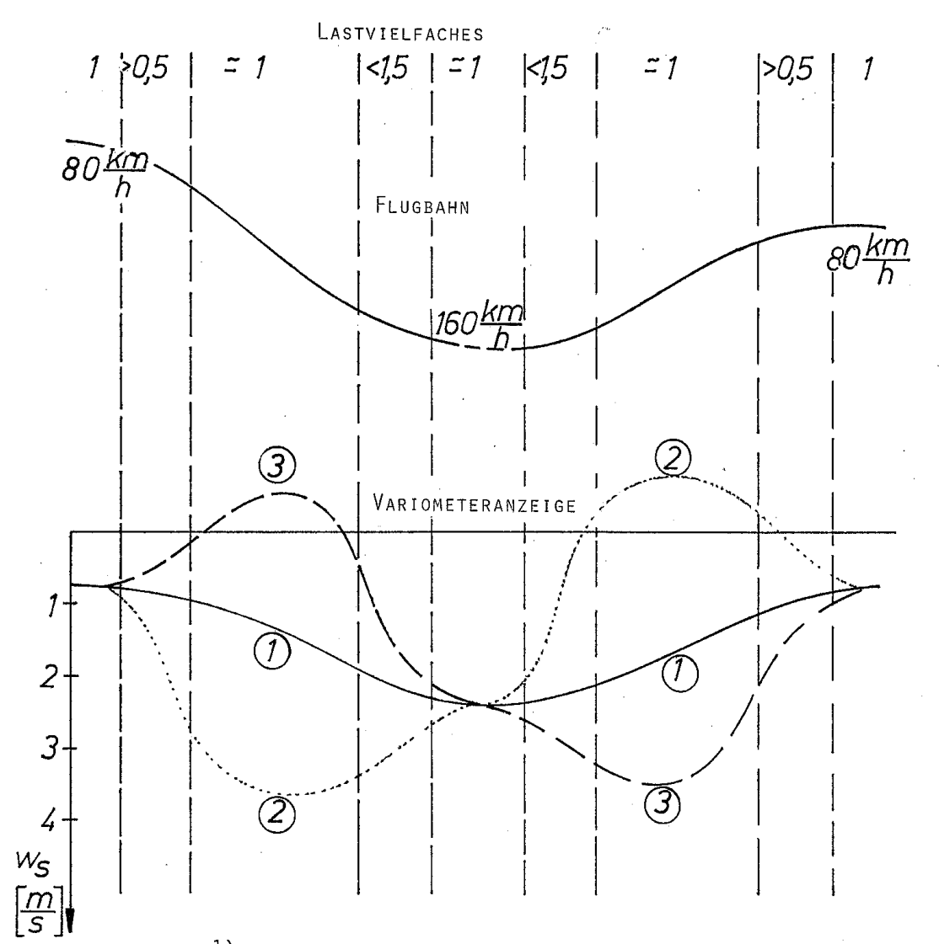
g-force
flight path
Obviously,
it is a good
idea to keep
g-force low
during a
test flight.
So please fly in
calm air and try
to descend and
climb at an
angle of about
20° - 25°
maximum.
Picture: Totalenergiekompensation
von Variometern, p. 26, Volker Cseke, Hannover 1986

Slide 14
g-force
If compensating
well, your TEK-
Vario will indicate
a slow sink as
long as speed
increases
flight path
and a slow climb
as long as speed
decreases
1 = good compensation
and indicate
the loss of
height caused
by the
maneuver.
Picture: Totalenergiekompensation
von Variometern, p. 26, Volker Cseke, Hannover 1986

Slide 15
g-force
flight path
If undercompen-
sating, your TEK-
Vario will indicate
a (by far more)
distinct descent
during
speed change.
or climb
You will hear this
about one
second or so after
pushing or
pulling the stick.
2 = under- compensation
Picture: Totalenergiekompensation
von Variometern, p. 26, Volker Cseke, Hannover 1986

Slide 16
g-force
flight path
If overcompen-
sating, your TEK-
Vario will indicate
a climb while you
are descending
and a descent
while you are
climbing.
3 = over- compensation
Again, about one
second or so after
pushing or
pulling the stick.
Picture: Totalenergiekompensation
von Variometern, p. 26, Volker Cseke, Hannover 1986

Slide 17
10.5 FAQs: How will I know if my TEK-Vario works as it is supposed to?
So what?

Slide 18
10.5 FAQs: How will I know if my TEK-Vario works as it is supposed to?
So what?
If your TEK-Vario undercompensates, it is worth trying to increase suction (see Part II, pages 8 ff) by adding some kind of washer to the flange of the Braunschweiger probe. Of course its centre hole should be identical to the one in your probe and its diameter somewhat bigger than that of the flange.

Slide 19
10.5 FAQs: How will I know if my TEK-Vario works as it is supposed to?
So what?
If your TEK-Vario undercompensates, it is worth trying to increase suction (see Part II, pages 8 ff) by adding some kind of washer to the flange of the Braunschweiger probe. Of course its centre hole should be identical to the one in your probe and its diameter somewhat bigger than that of the flange.
If your TEK-Vario overcompensates, it is worth trying to reduce suction
by sticking some tape on the flange in order to make the centre hole a bit smaller. Properly trim the tape at the brim. Good luck! ☺

Slide 20
10.6 FAQs: What is the speed range of a TEK-Vario?
A Braunschweiger Düse normally works well within a speed range of approximately 30 km/h up to around 120 km/h. If you fly considerably faster than that, you can only guess what you will get.

Slide 21
10.7 FAQs: There are so many different types of TEK-probes. Why do
most people use the Braunschweiger type?
Meanwhile it is a proven fact that the Braunschweiger Düse performs best. It copes quite well with different angles of attack. It also keeps working properly at bigger yaw angles than other probes.
Please don´t forget: On full-size gliders there is a yaw string to support the pilot. We as model pilots simply can´t see if our glider yaws or not most of the time.

Slide 22
10.8 FAQs: Usually the tube that comes with a TEK-Vario is of PTFE. Is it a
must or would silicon rubber do as well?
Because pressure is fairly low, silicon rubber is fine. But please do try to keep volumes low und therefore use small inner diameters.

Slide 23
10.9 FAQs: What is the best place for a Braunschweiger Düse?
Whenever possible, you should mount it to the fin. Fairly high up, really. The idea is to make the probe protrude into undisturbed air.
If you can´t, things get a lot more complicated. Some people opt for a spot about halfway between the trailing edge of your wings and the fin. We don´t agree with that. Whenever the model yaws, the vortices of the Braunschweiger probe are disturbed considerably as the tail moves either side. This is the main reason why we suggest to fix the probe as close to the wings as possible. If the probe is close to the trailing edge and about 12 to 14 cm above the wings, you should be fine. Of course the Braunschweiger probe can also be fixed somewhere in front of the wings.

Slide 24
10.10 FAQs: I use TEK-Varios in a whole range of different models. What worries me, ist that they seem to work quite differently.
Well, that is the natural thing to happen. After all, those varios work in completely different flying systems. If there are any concerns, test fly your model as suggested above.

Slide 25
10.11 FAQs: Are logged data of any help for finding out what´s wrong or has turned for the better or worse after a change?
No.

Slide 26
10.12 FAQs: What about small climb rates in a competition?
If your net climb is only up to 0.3 m/s, you certainly would reduce flying speed to make use of that positive fact as long as possible. But you wouldn´t start circling, because in this case your sink rate would increase considerably.

Slide 27
10.13 FAQs: How can I find out the glide ratio of a particular model
setup?
The glide ratio is the distance covered divided by the height lost while doing so.
So just fly a triangle early in the morning. Multiply the perimeter of your triangle by your index. Thus you get the distance flown. Divide it by the height lost during the flight. There you are.
You have to do such test flights repeatedly, of course.

Slide 28
10.14 FAQs: Why is it that models sometimes sink at a rate smaller than
their standard sink rate in early the morning?
You never can be a hundred per cent sure that the air is as neutral as you expect it to be.
Besides, we know that we sometimes fly through areas where the air is more humid than in other places. The more humidity there is, the lighter the air. So these bulks of air have a tendency to rise. Yet, due to inversion, they can´t really yet.

Slide 29
10.15 FAQs: What about the quality of the TEK-Varios available?
In your opinion, what is “quality“? At first sight, you might consider a vario that is very responsive to pressure changes a vario of good quality.
Yet, if we give it a second thought, we may agree that it is the vario system as a whole that tells us of what quality it is. For example, we should take into consideration at what rate pressures are taken, at what rate data are transferred to the receiving unit on the ground and how fast and detailed signals are presented, especially around the ”0“-zone.
In Neresheim one participant had his TEK-Vario signals (Raven 2 pro, RC Electronics) read out via the standard channel of his rc system and Andrej Vrecer´s receiver (Snipe) in parallel. Differences were distinct!

Slide 30
10.15 FAQs: What about the quality of the TEK-Varios available?
Whichever TEK-Vario suits you best, we recommend you not to mix components of different brands. If you use a Snipe 2 from RC Electronics, for example, the best idea is to use their TEK probe and receiver as well.

Slide 31
How come?
Although not taking part in rc gliding competitions of any kind, I have been fascintated by thermal soaring for many decades. Of course I have been using TEK-Varios more and more frequently in recent years. Since I am that kind of person that “has always wanted to know“, I have gathered any information on the TEK-Vario I could put my hands on for quite a while. By the time I turned up in Neresheim, I had a big box full of puzzle pieces, some of which already formed smaller or bigger patches. Yet the big picture was still missing. I just do hope that after going through these four parts you feel that it is there now.
Many hearty thanks to Andrej Vrecer and Philip Kolb for inviting me and answering “just any“ question. Many thanks to every single one of that wonderful bunch of model pilots that you are. Spending that weekend together was simply great.
Feel free to pass these files on to anybody interested.
See you then
Michael Rogg

