Slide 1
Towards a Better Understanding Of the TEK-Vario
Part II

Slide 2
9 The Braunschweiger Düse (probe)
Please remember: total energy compensation = 1 + -1 = 0
Before we go for the real thing, let´s have a quick look at a probe
that does NOT meet the demand stated above:
We simply stick a piece of tube to the fin of our glider and see what happens…
Anströmung

Slide 3
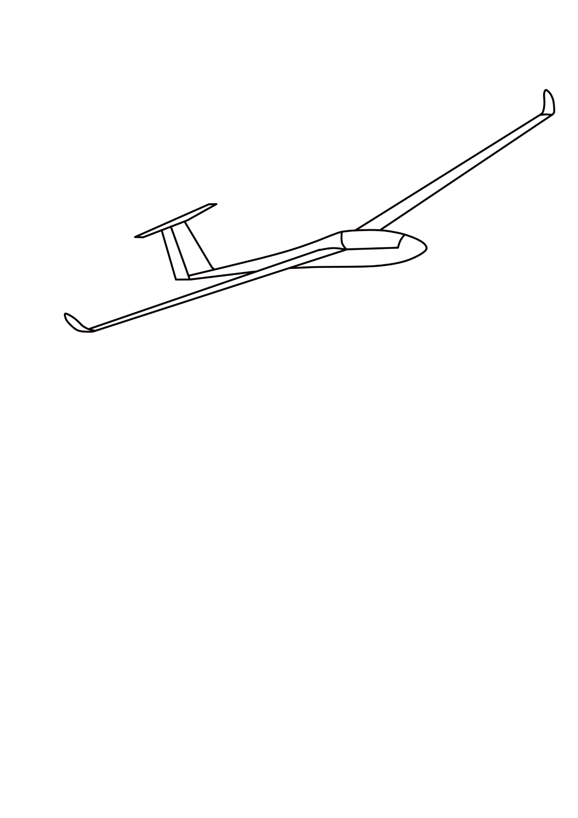
9 The Braunschweiger Düse (probe)
Anströmung
This probe takes the total air pressure of the moving glider.
Whatever its value may be in numbers, it will be a POSITIVE one.
So obviously this kind of probe is of no use at all.

Slide 4
9 The Braunschweiger Düse (probe)
Anströmung
As arithmetic tells us: We need a probe that
TAKES POSITIVE PRESSURE YET DELIVERS A NEGATIVE VALUE.

Slide 5
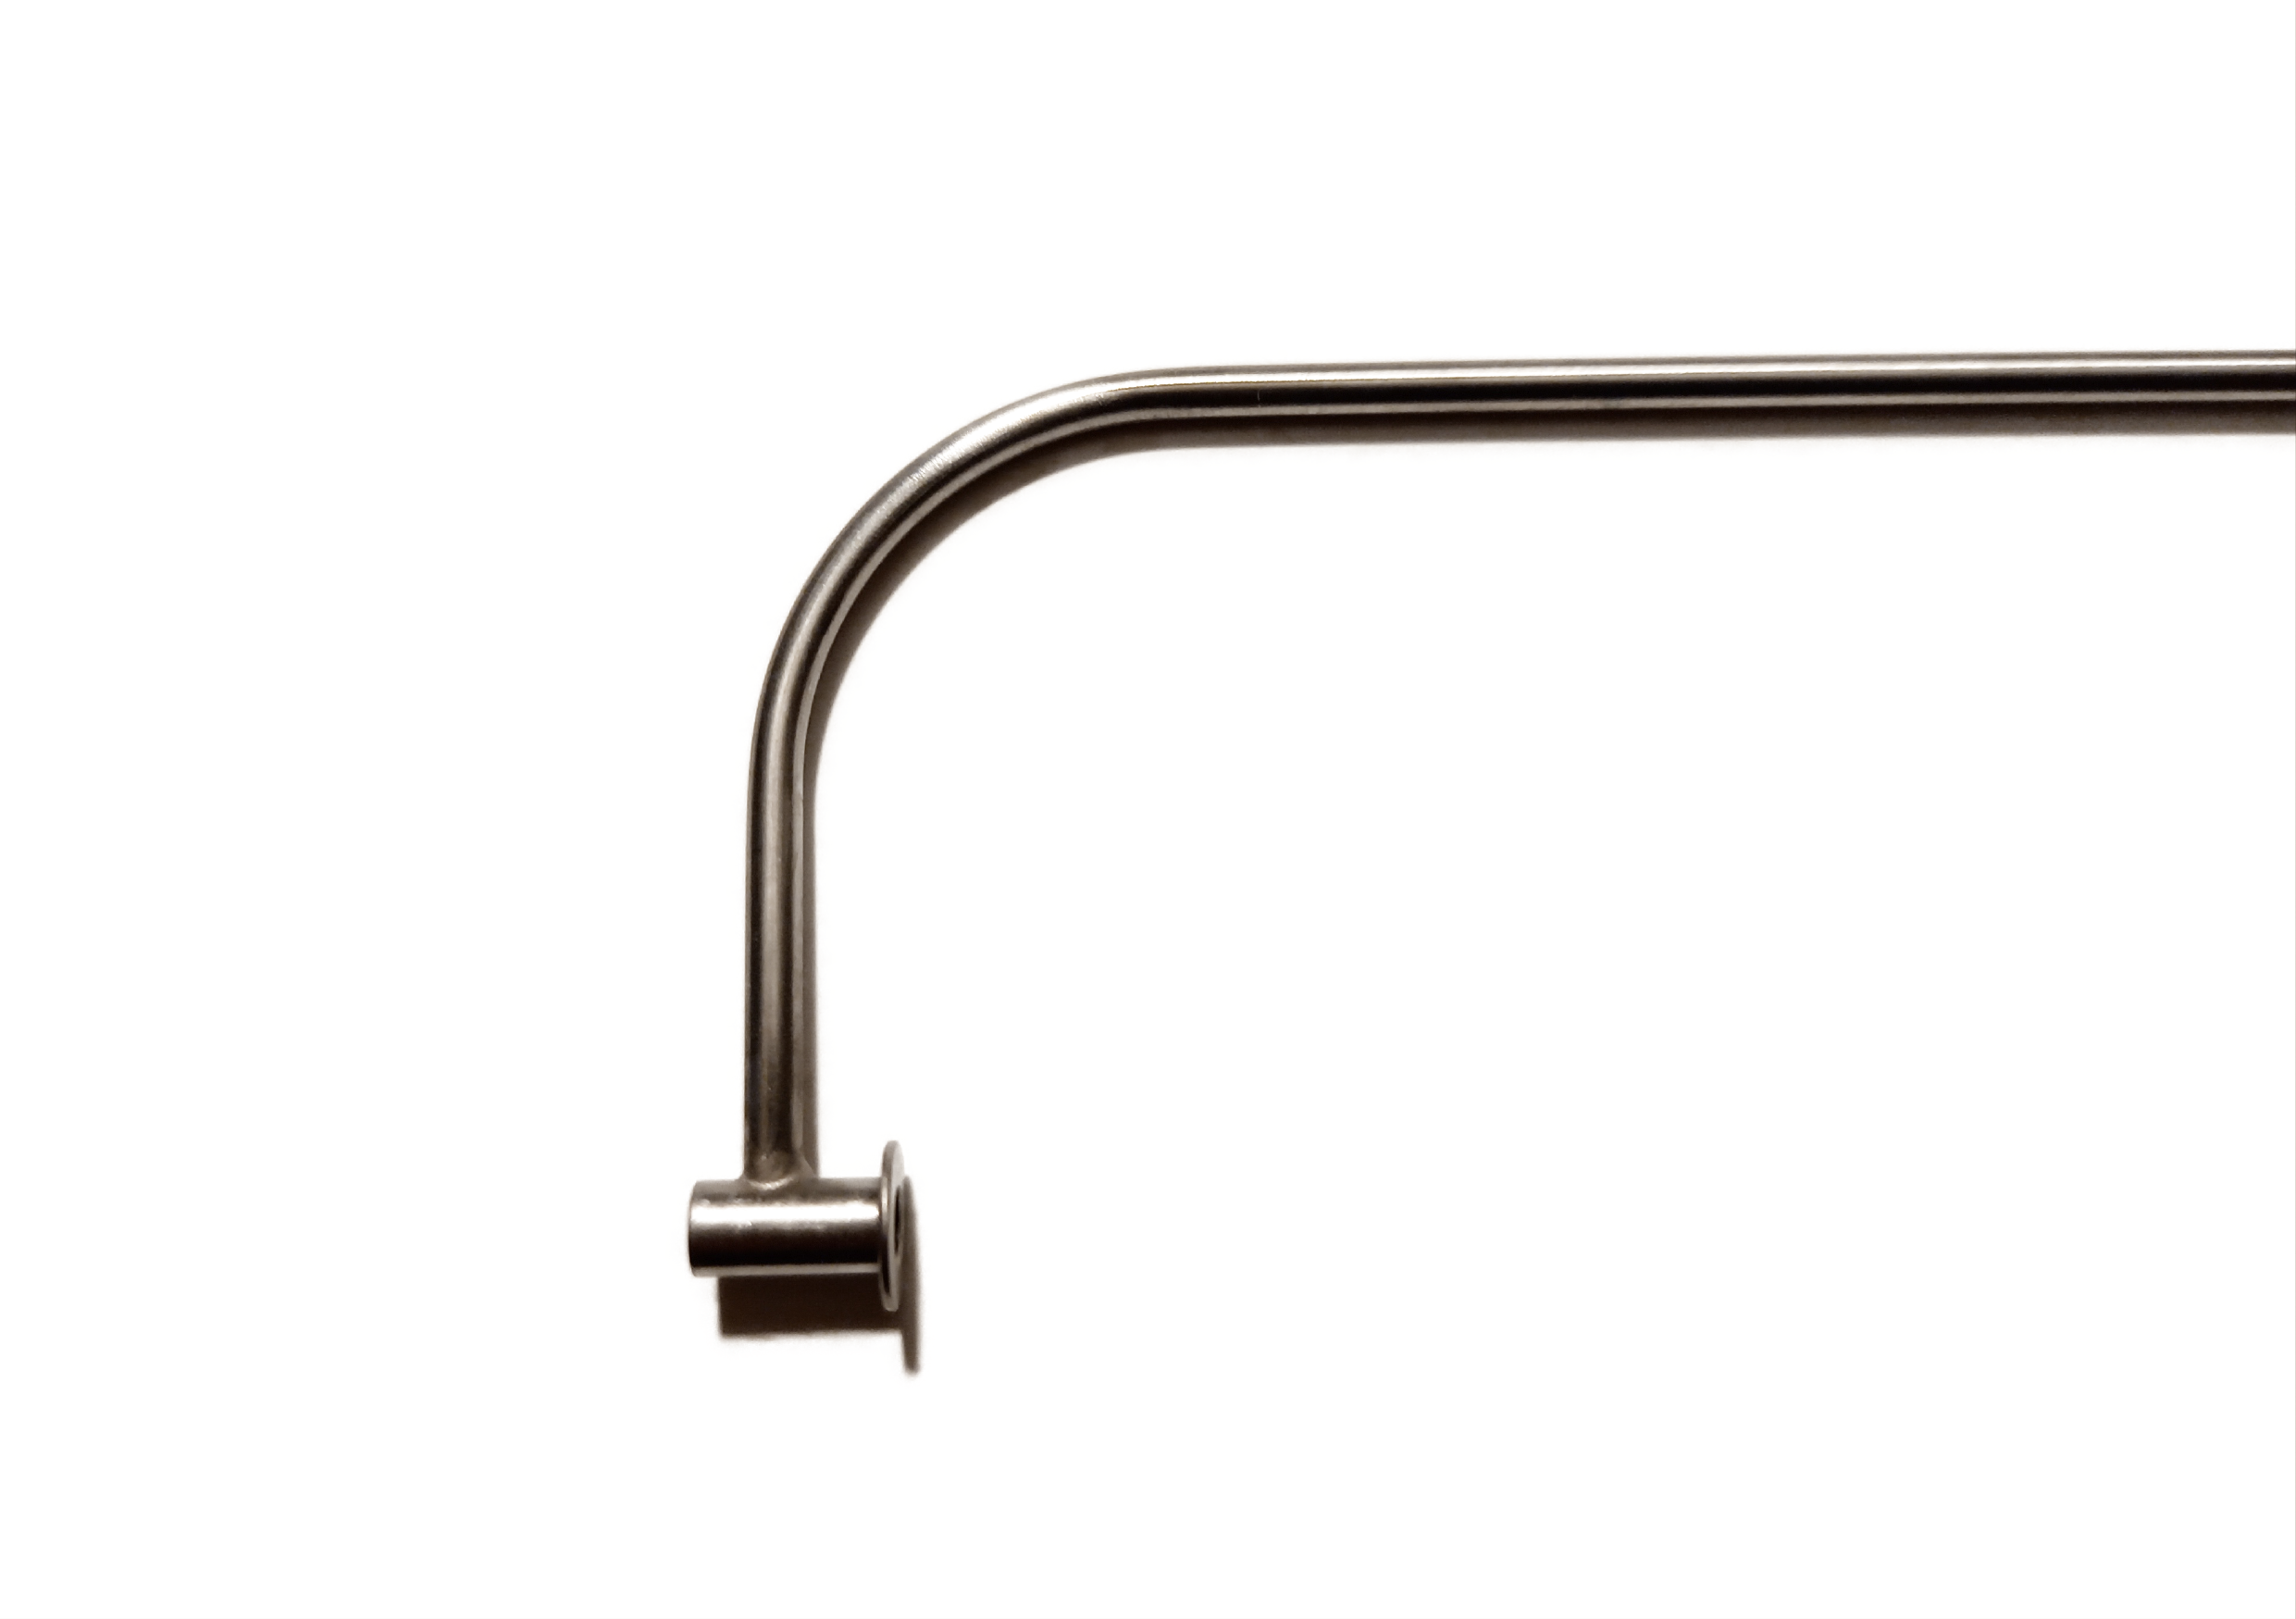
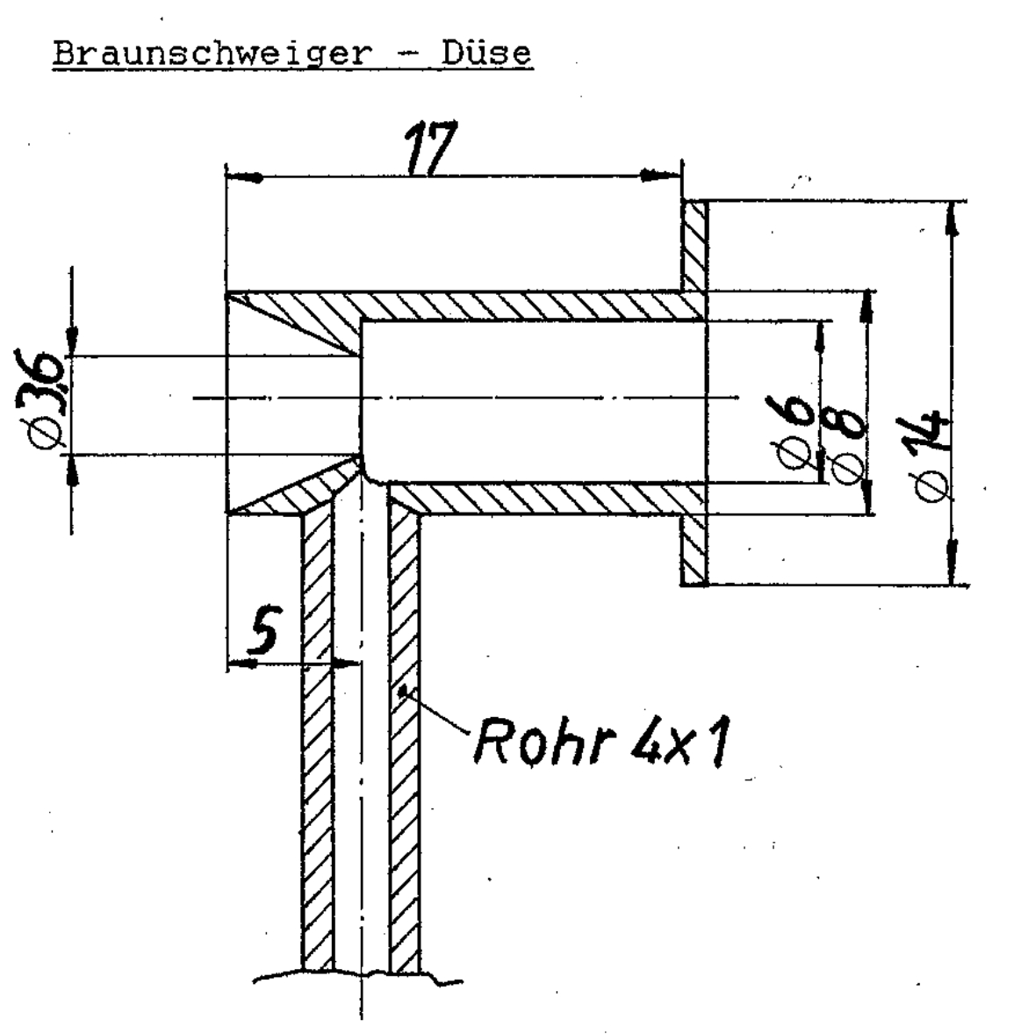
9 The Braunschweiger Düse (probe)
This is where the Braunschweiger Düse (probe) comes in:
Photo: Michael Rogg
Cross section: Totalenergiekompensation von Variometern,
p. 28, Volker Cseke, Hannover 1986

Slide 6
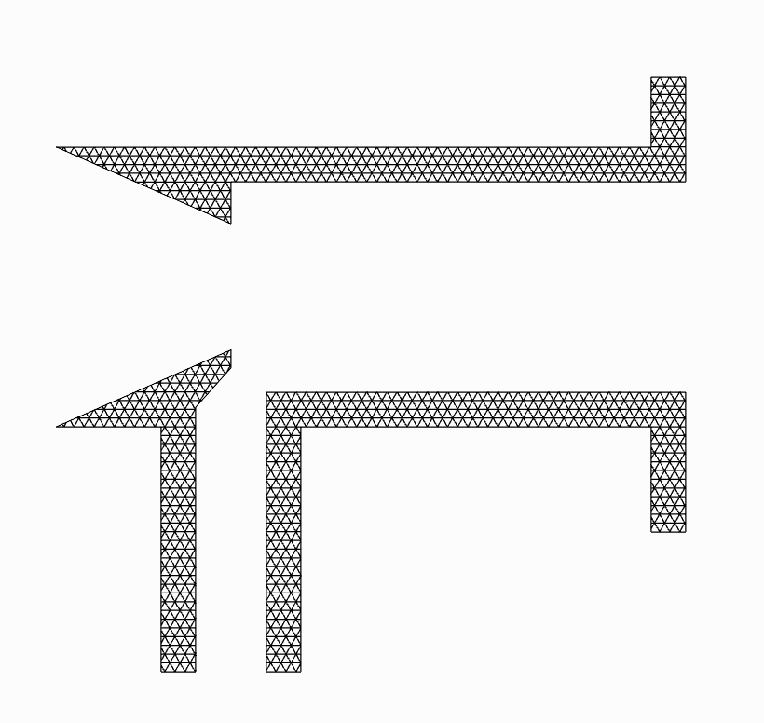
9 The Braunschweiger Düse (probe)
flight direction
What happens, when incoming air flows through the probe?
incoming air
connecting tube:
probe -> 2nd pressure sensor

Slide 7
9 The Braunschweiger Düse (probe)
Due to this narrowing…
and expands
in here.
incoming air…
accelerates when
it enters the probe…

Slide 8
9 The Braunschweiger Düse (probe)
We get vortices…
here…
and here.

Slide 9
9 The Braunschweiger Düse (probe)
As a result…
pressure drops
and air is sucked out.
And consequently…
pressure drops in the connecting
tube as well.

Slide 10
9 The Braunschweiger Düse (probe)
The rule is:
The higher p1,
the lower p2.
And vice-versa!
p1
p2

Slide 11
9 The Braunschweiger Düse (probe)
Since the value of p1 varies according to
changes in
Epot and Ekin…
p1
p2
we get a
matching value of
-Ekin.

Slide 12
9 The Braunschweiger Düse (probe)
So much for theory!
In practice, it is a fact that we use the Braunschweiger probe in a whole range of different flying systems. It is obvious that, if we use only one specific type of TEK-Vario in as many different gliders as there are available, we will get quite different outputs from our TEK-Vario.
If you agree with this statement and at the same time start asking yourself: But how on earth will I know, if…?
The answer is: You are welcome to study parts III and IV.☺

