Slide 1
Towards a Better Understanding Of the TEK-Vario
Part I

Slide 2
The other day at the flying field…
„My model is flying well and my conventional vario is beeping happily. Why should I bother using a TEK-Vario instead?“

Slide 3
The other day at the flying field…
„My model is flying well and my conventional vario is beeping happily. Why should I bother using a TEK-Vario instead?“
If you can´t be bothered: Stop reading here. You´d better go flying.

Slide 4
The other day at the flying field…
„My model is flying well and my conventional vario is beeping happily. Why should I bother using a TEK-Vario instead?“
If you can´t be bothered: Stop reading here. You´d better go flying.
If you want to acquire knowledge and use this knowledge to improve your skills: Welcome! Your are the one we readily sacrifice our spare time for. We do hope you will enjoy reading on!
Andrej Vrecer, Philip Kolb, Michael Rogg, Neresheim, March 2025

Slide 5
A TEK-VARIO* is a vario with:
TOTAL
ENERGY
K/COMPENSATION
* Please note: For various reasons, the author decided to use the German term and qoute it throughout.

Slide 6
A TEK-VARIO is a vario with:
TOTAL
ENERGY
K/COMPENSATION
As for energy, we will have to deal with:
potential energy (Epot)
kinetic energy (Ekin)

Slide 7
A TEK-VARIO is a vario with:
TOTAL
ENERGY
K/COMPENSATION
Let´s find out what
all these terms
mean in detail.
potential energy (Epot)
kinetic energy (Ekin)

Slide 8

1 Air Pressure and Height
The higher you get in the atmosphere, the less air molecules there are.

Slide 9
1 Air Pressure and Height
height 100 m
less air molecules -> lower air pressure
If height increase is 8 m,
air pressure decreases
by 1 mbar. (0-5000 m ASL)
height 0 m
more air molecules -> higher air pressure

Slide 10
1.1 Static/Ambient Air Pressure
height 100 m
lower static air pressure
What is “static“ air pressure?
height 0 m
higher static air pressure

Slide 11
1.1 Static/Ambient Air Pressure
height 100 m
lower static air pressure
What is “static“ air pressure?
Here “static“ means:
“still“, “not moving“
height 0 m
higher static air pressure

Slide 12
1.1 Static/Ambient Air Pressure
height 100 m
lower static air pressure
What is “static“ air pressure?
“Static“ air pressure means the force which not moving air exerts on its surrounding.
height 0 m
higher static air pressure

Slide 13
1.1 Static/Ambient Air Pressure
height 100 m
lower static air pressure
A conventional vario simply measures
“static air pressure“, usually called “ambient pressure“.
height 0 m
higher static air pressure

Slide 14
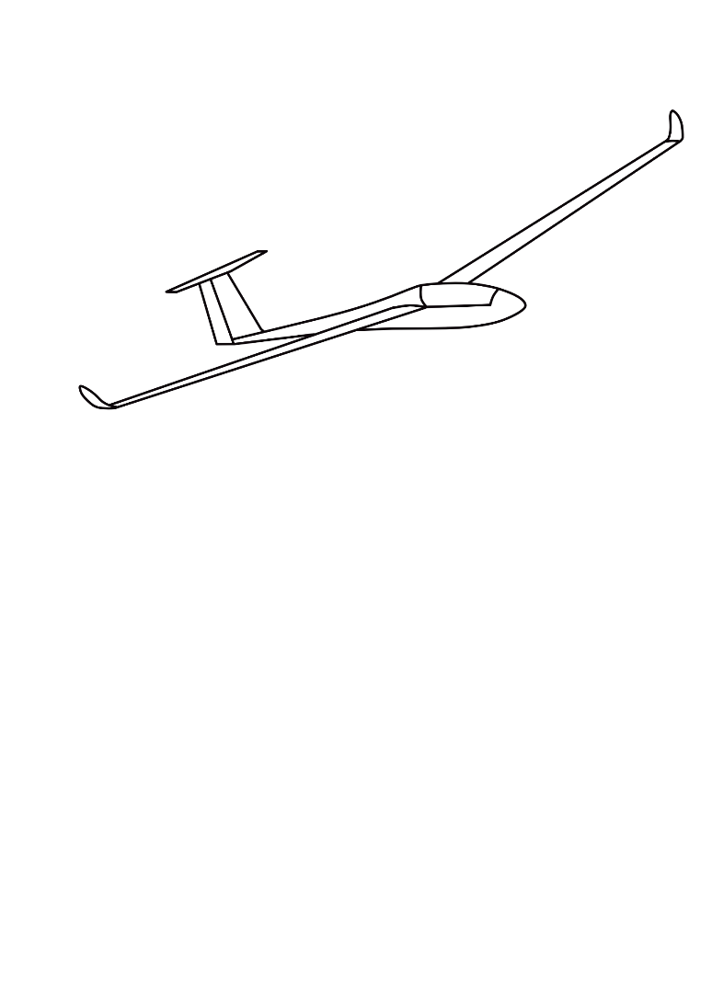
1.2 Static/Ambient Air Pressure and Conventional Vario
height 100 m
lower static air pressure
A vario in its glider is taken to different heights. There it measures the prevailing
ambient pressure.
A conventional vario indicates changes in ambient pressure either as a “climb“ or as a “descent“.
height 0 m
higher static air pressure

Slide 15

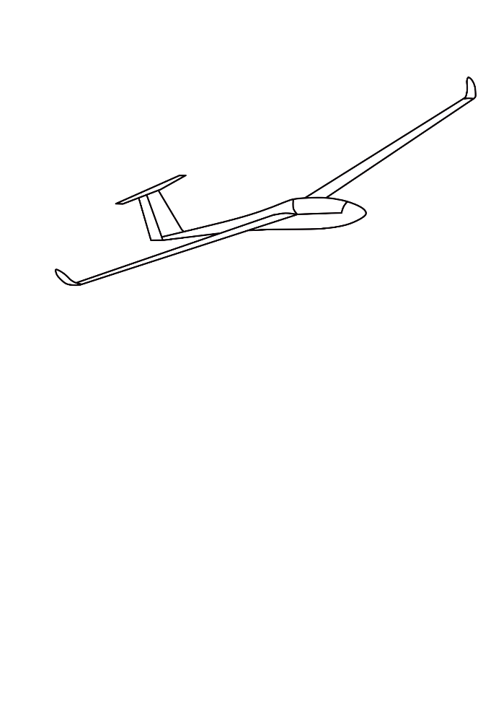
1.2 Static/Ambient Air Pressure and Conventional Vario
height 100 m
lower static air pressure
Whenever the glider sinks, ambient pressure increases. You can hear a permanent, dark sound.
Whenever the glider climbs, ambient pressure decreases. You can hear a bright sound at intervals.
height 0 m
higher static air pressure

Slide 16
1.2 Static/Ambient Air Pressure and Conventional Vario
Are you familiar with the following terms now?
Air molecules, height, static pressure, ambient pressure, vario, climb, descent, dark and permanent sound, bright sound at intervals
Then let´s go on to the next topic…

Slide 17
2 What is Potential Energy?
Please remember this basic physical law:
We never “lose“ or “use up“ energy.
We just TRANSFORM energy.
So let´s play “Transformers“ from now on ☺.
LAE-
ENER-
GIE

Slide 18

2 What is Potential Energy?
height 100 m
height 50 m
At a height of 0 m, the
potential energy
of this car is “0“.
height 0 m

Slide 19
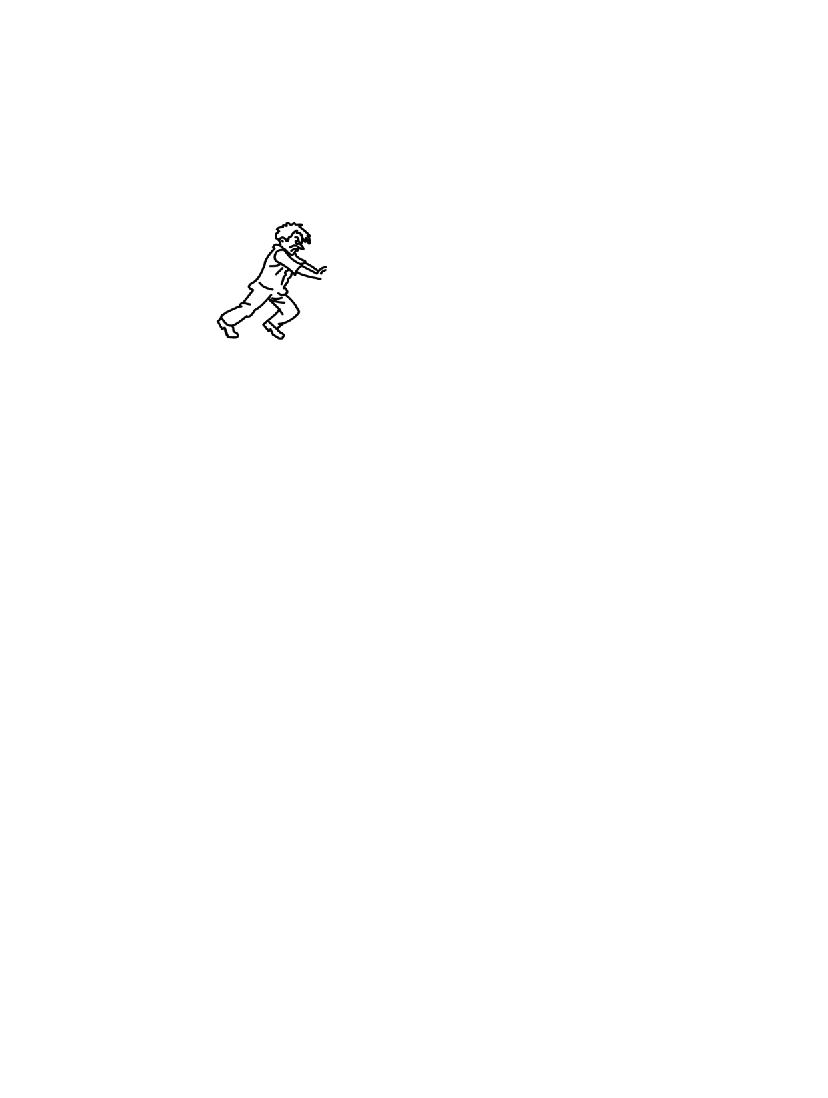
2 What is Potential Energy?
height 100 m
Now this man wants to push his car uphill to a height of
50 m. To be able to do so, he needs a certain
amount of muscle energy. He draws his energy from a…
LAE-
ENER-
GIE
height 50 m
height 0 m

Slide 20

2 What is Potential Energy?
height 100 m
LAE-
ENER-
GIE
height 50 m
height 0 m

Slide 21
2 What is Potential Energy?
height 100 m
LAE-
ENER-
GIE
As he pushes the car uphill, the muscle energy of the man
is gradually transformed into potential energy of the car.
height 50 m
height 0 m

Slide 22

2 What is Potential Energy?
height 100 m
At a height of 50 m, the complete muscle energy of the man has been transformed into potential energy of the car. Now the car has the potential energy of “1 sausage“.
LAE-
ENER-
GIE
height 50 m
height 0 m

Slide 23
2 What is Potential Energy?
height 100 m
This potential energy let´s the car roll down the slope.
Halfway down the slope, only “half a sausage“ of energy is left.
height 50 m
When the car comes to a standstill at a height of 0 m,
The “sausage“/potential energy is “0“ again.
height 0 m

Slide 24
2 What is Potential Energy?
height 100 m
Guess what!
height 50 m
height 0 m

Slide 25
2 What is Potential Energy?
height 100 m
How many “sausage units“ of energy does the man need to push his car up to a height of 100 m?
height 50 m
?
height 0 m

Slide 26
2 What is Potential Energy?
height 100 m
Yes, indeed:
2 “sausage units of energy“
will do the trick.
LAE-
ENER-
GIE
height 50 m
height 0 m

Slide 27
2 What is Potential Energy?
LAE-
ENER-
GIE
height 0 m

Slide 28
2 What is Potential Energy?
LAE-
ENER-
GIE
The same is true for gliders, of course.

Slide 29
2 What is Potential Energy?
Epot
LAE-
ENER-
GIE
The rule is:
Twice the height
equals twice the potential energy.

Slide 30
3 Your Conventional Vario and Potential Energy
Now let´s combine what we have discussed so far.

Slide 31
3 Your Conventional Vario and Potential Energy
height 100 m
lower static air pressure
Epot
Although simply measuring ambient air pressure, our conventional vario indicates the potential energy
of our glider.
height 0 m
higher static air pressure

Slide 32
3 Your Conventional Vario and Potential Energy
Epot
Ambient air pressure and potential energy increase or decrease linearly.

Slide 33
4 A Closer Look at Different Inflight Situations
 | climb | descent | Vario
1 | Long and steady (initial) climb | Long and steady (final) descent
2 | Short climb by pulling the elevator | Short descent by pushing the elevator
3 | Phugoid | Phugoid
4 | Flight mode change (speed -> thermal) | Flight mode change (thermal -> speed)
5 | Transition from a banked turn into straight and level flight | Transition from straight and level flight into a banked turn
6 | Transition from falling air into rising air | Transition from rising air into falling air
7 | Flying upwind, hit by an oncoming gust | Flying downwind, hit by a gust from the rear
8 |  | Sinking in falling air at a rate bigger than the glider´s sink rate.
9 |  | Sinking in neutral air at the glider´s sink rate
10 |  | Climbing in a thermal, yet still sinking a bit (sink rate of the glider > thermal)
11 | Real climb in a thermal (thermal > sink rate)

Slide 34
4 A Closer Look at Different Inflight Situations
Does our conventional vario indicate all the resulting
climbs and descents?

Slide 35
4 A Closer Look at Different Inflight Situations
Yes!
 | climb | descent | Vario
1 | Long and steady (initial) climb | Long and steady (final) descent | ü
2 | Short climb by pulling the elevator | Short descent by pushing the elevator | ü
3 | Phugoid | Phugoid | ü
4 | Flight mode change (speed -> thermal) | Flight mode change (thermal -> speed) | ü
5 | Transition from a banked turn into straight and level flight | Transition from straight and level flight into a banked turn | ü
6 | Transition from falling air into rising air | Transition from rising air into falling air | ü
7 | Flying upwind, hit by an oncoming gust | Flying downwind, hit by a gust from the rear | ü
8 |  | Sinking in falling air at a rate bigger than the glider´s sink rate. | ü
9 |  | Sinking in neutral air at the glider´s sink rate | ü
10 |  | Climbing in a thermal, yet still sinking a bit (sink rate of the glider > thermal) | ü
11 | Real climb in a thermal (thermal > sink rate) |  | ü

Slide 36
4 A Closer Look at Different Inflight Situations
Is this what the pilot needs?

Slide 37
4 A Closer Look at Different Inflight Situations
No!
 | climb | descent | Vario
1 | Long and steady (initial) climb | Long and steady (final) descent | ü
2 | Short climb by pulling the elevator | Short descent by pushing the elevator | ü
3 | Phugoid | Phugoid | ü
4 | Flight mode change (speed -> thermal) | Flight mode change (thermal -> speed) | ü
5 | Transition from a banked turn into straight and level flight | Transition from straight and level flight into a banked turn | ü
6 | Transition from falling air into rising air | Transition from rising air into falling air | ü
7 | Flying upwind, hit by an oncoming gust | Flying downwind, hit by a gust from the rear | ü
8 |  | Sinking in falling air at a rate bigger than the glider´s sink rate. | ü
9 |  | Sinking in neutral air at the glider´s sink rate | ü
10 |  | Climbing in a thermal, yet still sinking a bit (sink rate of the glider > thermal) | ü
11 | Real climb in a thermal (thermal > sink rate) |  | ü

Slide 38
4 A Closer Look at Different Inflight Situations
 | climb | descent | Vario
2 | Short climb by pulling the elevator | Short descent by pushing the elevator | ü
3 | Phugoid | Phugoid | ü
4 | Flight mode change (speed -> thermal) | Flight mode change (thermal -> speed) | ü
5 | Transition from a banked turn into straight and level flight | Transition from straight and level flight into a banked turn | ü
6 | Transition from falling air into rising air | Transition from rising air into falling air | ü
7 | Flying upwind, hit by an oncoming gust | Flying downwind, hit by a gust from the rear | ü
What do situations 2-7 have in common?

Slide 39
4 A Closer Look at Different Inflight Situations
 | climb | descent | Vario
2 | Short climb by pulling the elevator | Short descent by pushing the elevator | ü
3 | Phugoid | Phugoid | ü
4 | Flight mode change (speed -> thermal) | Flight mode change (thermal -> speed) | ü
5 | Transition from a banked turn into straight and level flight | Transition from straight and level flight into a banked turn | ü
6 | Transition from falling air into rising air | Transition from rising air into falling air | ü
7 | Flying upwind, hit by an oncoming gust | Flying downwind, hit by a gust from the rear | ü
In every single one of these situations, the glider changes its speed.

Slide 40
4 A Closer Look at Different Inflight Situations
So what´s the challenge?

Slide 41
4 A Closer Look at Different Inflight Situations
We have to improve our vario.
Our future vario…
must not
indicate altitude changes brought on by speed changes
and vice-versa.

Slide 42
5 Quick Check
Do you have a clear understanding of potential energy?
Do you have a clear understanding of how a conventional
vario measures it and what it indicates?
Do you have a clear understanding of “what is wrong“ with
a vario that only measures changes in height?
Then let´s take the next hurdle.

Slide 43

6 A Closer Look at Kinetic Energy
“Kinetic energy“ is the term for energy that is in moving things.
We already know how potential energy changes with height.
Now let´s find out, how kinetic energy changes with speed.
Let´s say, our candidate transforms 1 “sausage unit“ of energy into
kinetic energy in order to accelerate his car to a speed of 10 km/h.
10 km/h

Slide 44
6 A Closer Look at Kinetic Energy
How many units of “sausage energy“ does he need to double the speed?
?
10 km/h
20 km/h

Slide 45
6 A Closer Look at Kinetic Energy
Really?
Yes, indeed.
10 km/h
20 km/h

Slide 46
6 A Closer Look at Kinetic Energy
It´s because:
Whenever we deal with
kinetic energy, we deal
with squares.

Slide 47
6 A Closer Look at Kinetic Energy
Please don´t forget:
Are you ready for
the next step?

Slide 48

7 Total Energy
potential energy + kinetic energy
= total energy

Slide 49
7 Total Energy
If a glider pitches down, it picks up speed,…
potential energy is transformed into kinetic energy, yet…
total energy stays the same.
(Neglecting energy loss due to drag.)

Slide 50
7 Total Energy
If a glider pitches up, it loses speed,…
kinetic energy is transformed into potential energy, yet…
total energy stays the same.
(Neglecting energy loss due to drag.)

Slide 51
7 What we have learnt so far…
Potential energy changes …
Kinetic energy changes …
In this case … energy is … into …, yet …
In this case … energy is … into …, yet …
total energy stays the same, kinetic, energy, transformed, in squares, potential, energy, linearly

Slide 52
8.1 Energy Compensation
We have to think up some kind of device, that does not indicate a climb or descent, when potential energy is transformed into kinetic energy and vice-versa.
In other words: In these situations our vario must indicate “nothing“ or “0“. We can also say it must “COMPENSATE“ what is going on.

Slide 53
8.2 Total Energy Compensation
In fact, the logic behind a TEK-Vario is:
total energy compensation = potential energy + kinetic energy = 0
Now we know exactly, where the TEK-Vario got its name from…
and time has come to change from words to numbers completely:

Slide 54
8.3 Total Energy Compensation - Arithmetics
total energy compensation = potential energy + kinetic energy = 0
How can we convert this into numbers completely?
We know, that, if there is potential energy, it always is of positive value. (Otherwise the car wouldn´t roll downhill).
Therefore, setting up an arithmetic task, we must replace “potential energy“ by a positive number. Let´s take a “1“.
total energy compensation = potential energy + kinetic energy = 0
1

Slide 55
8.3 Total Energy Compensation - Arithmetics
total energy compensation = potential energy + kinetic energy = 0
How can we convert this into numbers completely?
We know, that, if there is potential energy, it always is of positive value. (Otherwise the car wouldn´t roll downhill).
Therefore, setting up an arithmetic task, we must replace “potential energy“ by a positive number. Let´s take a “1“.
total energy compensation = potential energy + kinetic energy = 0
What´s the missing number
to keep this task true?
1
?

Slide 56
8.3 Total Energy Compensation - Arithmetics
total energy = potential energy + kinetic energy = 0
How can we convert this into numbers completely?
We know, that, if there is potential energy, it always is of positive value. (Otherwise the car wouldn´t roll downhill).
Therefore, setting up an arithmetic task, we must replace “potential energy“ by a positive number. Let´s take a “1“.
total energy compensation = potential energy + kinetic energy = 0
Yes, it´s a negative number “1“
1
-1

Slide 57
8.4 Total Energy Compensation - Arithmetics + Reality
total energy compensation = 1 + -1 = 0
The logic involved here makes it crystal clear what kind of device we must look for:
The missing device must deliver exactly the opposite value of our conventional vario.

Slide 58
8.5 Total Energy Compensation - Summing Up
Let´s sum up:
Potential energy and kinetic energy are quite different by nature and therefore not easy to match.
In order to improve a conventional vario, we have to add a system that delivers exactly the opposite value of our conventional vario. What is more, this must happen at any time and in a system, where potential energy and kinetic keep changing and interacting rapidly and throughout.
For sure a heap of mind boggling problems. Nevertheless, already decades ago engineers found a brilliant solution…
Curious to know? Just start reading Part II!

